Slide 1
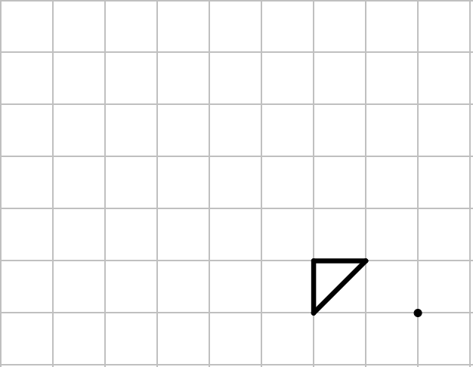
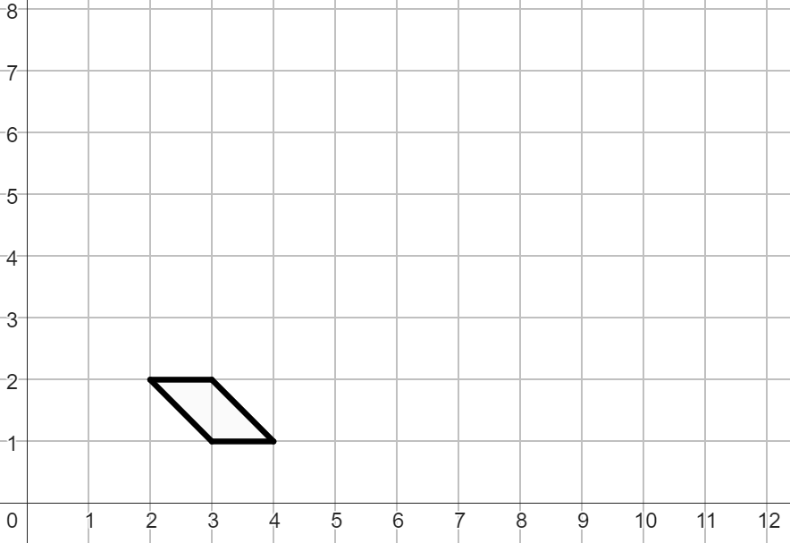
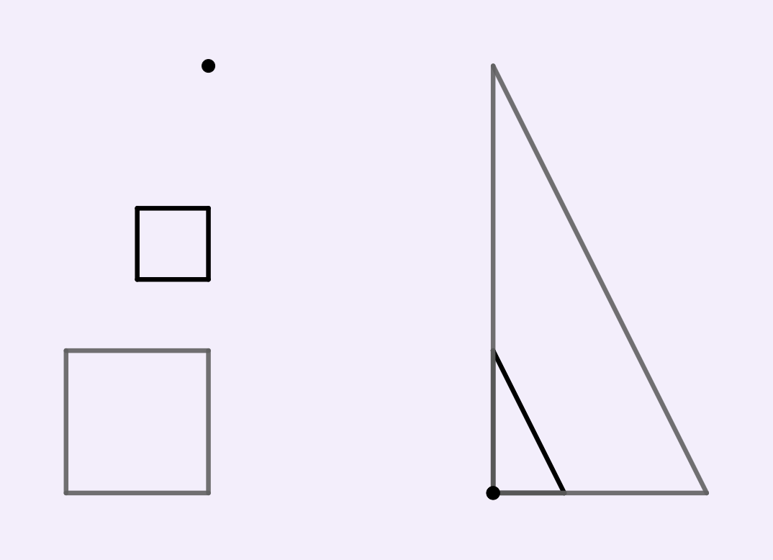
Enlarging objects
Task A: Enlarging using an integer scale factor
1) Enlarge the object by a scale factor of 3 from the point marked.
2) Enlarge the object by a scale factor of 4 from the point (2, 1).
3) Enlarge the object by a scale factor of 2 from the point marked.
4) Enlarge the object by a scale factor of 3 from the marked vertex.
1

Slide 2

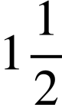
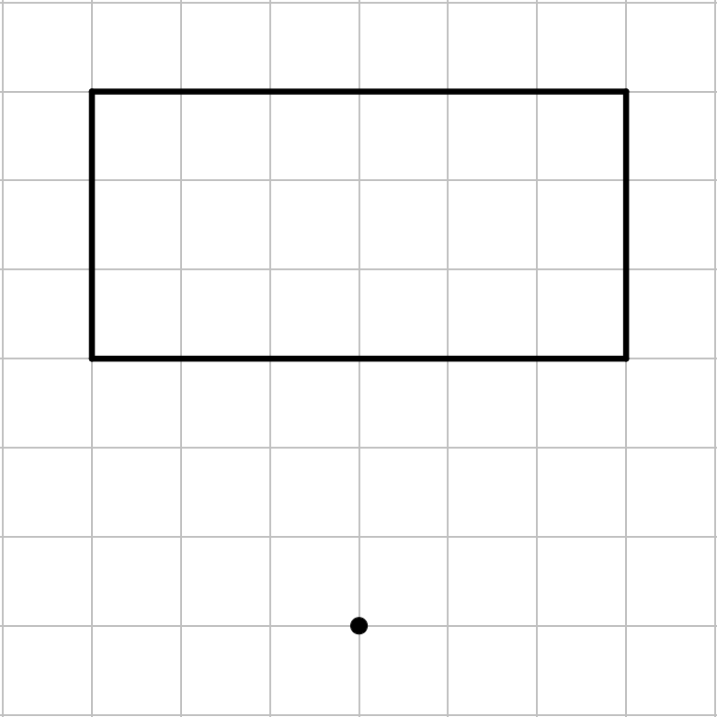
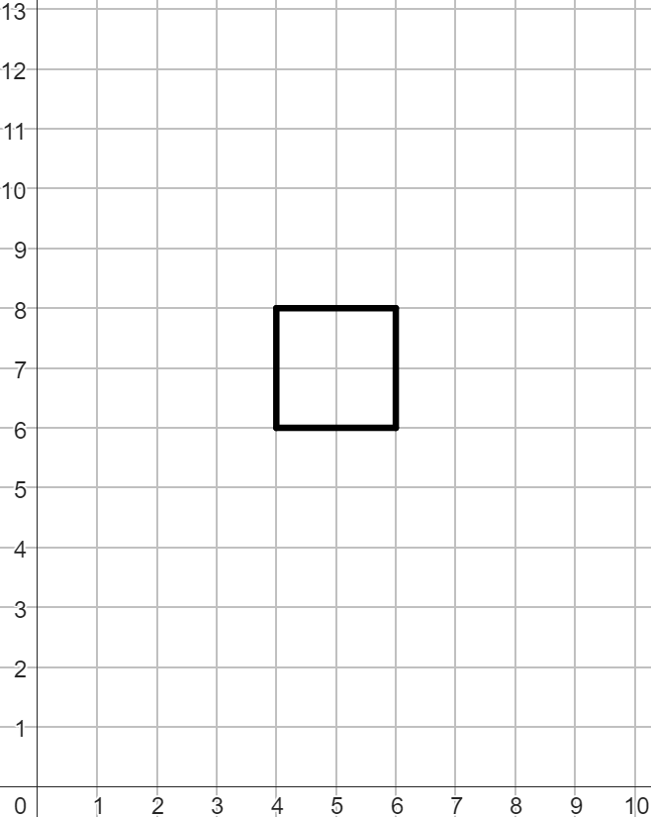


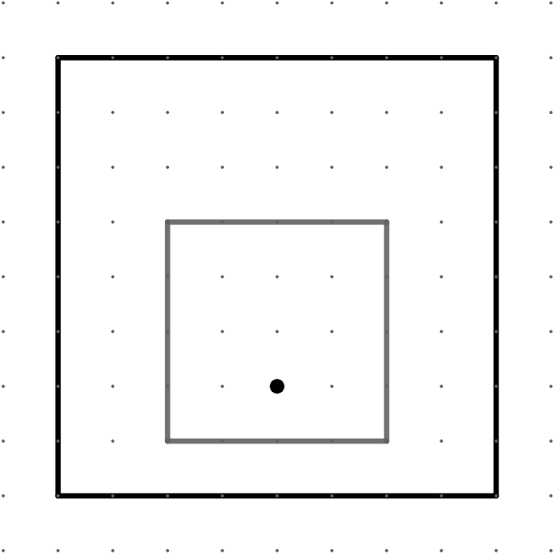
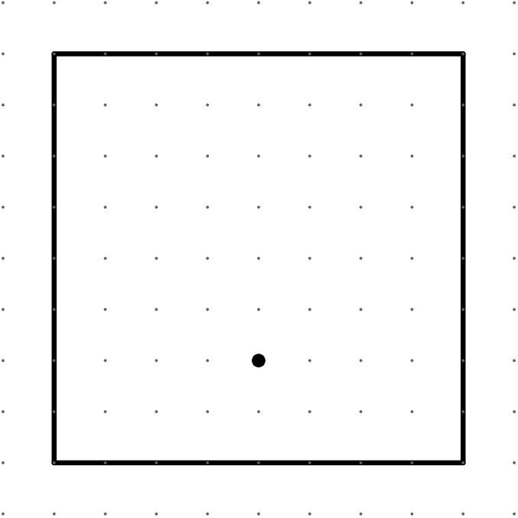

Enlarging objects
Task B: Enlarging using a non-integer scale factor
1)
a) Enlarge the object by a scale
factor of from the point marked.
b) Enlarge the object by a scale
factor of from the point (4, 0).
2)
a) Enlarge the object by a scale
factor of from the point marked.
b) Enlarge the object by a scale
factor of from the point marked.
Mathematics in Education and Industry
v2.1

